Slide 1

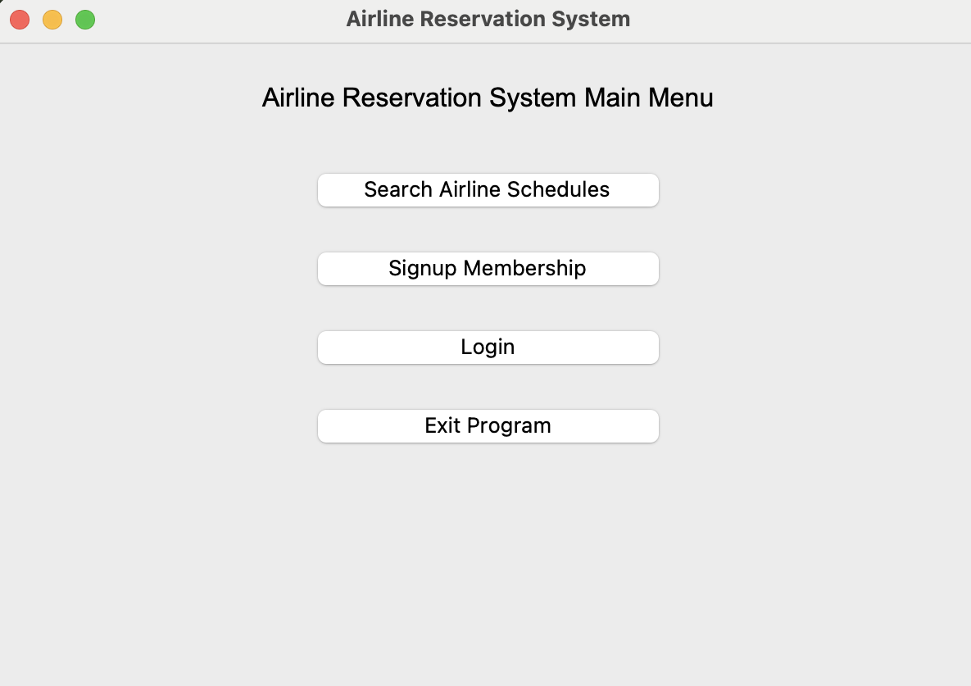
Airline Reservation System
By: Hanin Sherif
The Airline Reservation System allows users to book airline tickets and manage reservations.
https://github.com/ksu-is/Airline-Reservation-System/tree/main

